Slide 1

MACHINE LEARNING PROJECT
Accident Hotspot Prediction Using
Random Forest and Logistic Regression
A data-driven approach to predicting road-accident risk and supporting proactive traffic-safety decisions
P. Thanvitha — 2520030385
N. Tejasri — 2520030132
Guide: Jyothsna Datti

Slide 2

PROJECT SUMMARY
Abstract
Road accidents cause loss of life, injuries, and major economic damage — predicting risk areas helps authorities act early.
Two supervised algorithms — Random Forest and Logistic Regression — analyze weather, road, traffic, and vehicle factors.
Random Forest captures complex, non-linear relationships; Logistic Regression gives an interpretable probability estimate.
Workflow: data collection → preprocessing → feature selection → training → prediction → evaluation.
Accuracy, precision, recall and F1-score compare model performance; results are visualized for easy interpretation.
Goal: support traffic police, transport departments and urban planners with data-driven, proactive safety planning.
2

Slide 3
WHY THIS MATTERS
Introduction & Problem Statement
The Problem
Our Objective
Rising vehicle numbers, poor road conditions, weather, and human error drive road accidents.
Manual analysis of large accident datasets is slow and doesn't scale.
Authorities need a systematic way to flag high-risk conditions before accidents happen.
Build classification models that predict accident-severity risk from historical data.
Compare an ensemble method (Random Forest) against a linear baseline (Logistic Regression).
Surface the conditions — weather, time, road type — most linked to severe accidents.
Present findings through clear visual analytics for non-technical stakeholders.
3

Slide 4
PRIOR WORK
Literature Review — Overview
20
9+
6
5
Papers Reviewed
Use Random Forest
Use GIS / Spatial Clustering (DBSCAN, KDE)
Use Deep Learning (CNN, LSTM, MLP)
Key Themes Across the Literature
Random Forest is the most common ensemble choice for accident and crash-severity prediction.
Spatial methods (DBSCAN, KDE, Moran's I) locate hotspots; ML models then predict severity or risk.
SMOTE and similar resampling handle class imbalance in fatal/severe accident categories.
Most studies are region-specific (one city/province), limiting generalization to new areas.
4

Slide 5
PRIOR WORK
Literature Review — Representative Papers
Author(s) | Focus | Method | Limitation
Sancar & Oztas (2026) | Fatal accidents, Erzurum | Random Forest + SMOTE | Predicts fatality, not location
Ha Le Thi et al. (2025) | Accidents, Thanh Hoa | Random Forest + GIS mapping | Single province, short period
Gupta, Varun & Srinivasa (2022) | UK hotspot + severity | KDE + Random Forest + SMOTE | Proof-of-concept, one country
Atif Ali Khan & Hussain (2024) | Urban traffic, Faisalabad | Moran's I + Random Forest | Decision Tree outperformed RF
Rusmin Saragih et al. (2026) | Spatiotemporal risk, Medan | Hybrid CNN-LSTM vs RF | High compute & data needs
Research gap
Most prior work targets one region, one outcome (fatality OR location), or needs heavy spatial/GPS data. This project directly compares an ensemble (Random Forest) against an interpretable baseline (Logistic Regression) on a multi-state accident dataset — balancing accuracy with explainability.
5

Slide 6
DATA
Dataset Overview
3,000
22
2018–2023
3
Accident Records
Features / Columns
Years Covered
Severity Classes
About This Dataset
Each record captures a single accident with its full context: when and where it happened, how severe it was, and the conditions surrounding it.
Records are drawn from multiple states and cities, giving the models a genuinely multi-region view rather than one city's traffic patterns.
The four feature groups — Location & Time, Accident Details, Environment, and Driver & Vehicle — are detailed on the next slide.
6

Slide 7
DATA
Dataset — Feature Groups Captured
Location & Time / Accident Details
Environment / Driver & Vehicle
Where and when the accident occurred, and the direct outcome recorded.
Conditions on the road and who was involved at the time of the accident.
State, City, Year, Month, Day of Week, Time of Day
Severity, Vehicles Involved, Casualties, Fatalities
Weather, Road Type, Road Condition, Lighting, Speed Limit
Vehicle Type, Driver Age, Gender, License Status, Alcohol Involvement
Together these 22 columns feed both models — categorical fields are label-encoded, and the target (Accident Severity) is derived from the Severity column.
6

Slide 8
DATA
Data Quality & Preprocessing
Data Quality Check
Preprocessing Steps
0 duplicate rows found
1,691 missing values overall
716 missing: Traffic Control Presence
975 missing: Driver License Status
Fill missing categorical values (Traffic Control, License Status) with an explicit 'Unknown' category
Label-encode categorical features (weather, road type, gender, etc.) for model compatibility
Encode the target — Accident Severity — into Fatal / Minor / Serious classes
Split into 80% training and 20% testing sets, stratified by severity class
Train Random Forest and Logistic Regression on identical train/test splits for fair comparison
7

Slide 9
METHODOLOGY
Proposed System — Workflow Stages
Collection & Preparation
Modeling & Evaluation
Data Collection — gather 3,000 historical accident records across states and years
Preprocessing — fill missing values and label-encode categorical fields
Feature Selection — retain the location, environment, and driver/vehicle fields most relevant to severity
Train/Test Split — 80% training, 20% testing, stratified by severity class
Model Training — fit Random Forest and Logistic Regression on the same training split
Prediction — generate severity predictions (Fatal / Serious / Minor) on the held-out test set
Performance Evaluation — compare both models using Accuracy, Precision, Recall and F1-Score
8

Slide 10
METHODOLOGY
Evaluation Metrics
Accuracy & Precision
Recall & F1-Score
How often the model's predictions can be trusted overall and per class.
How completely the model finds real cases, balanced against precision.
Accuracy — overall share of correct predictions
Precision — of predicted-positive cases, how many were correct
Recall — of actual-positive cases, how many were found
F1-Score — harmonic balance of precision and recall
All four metrics are computed on the same held-out 20% test split for both models, so the comparison on the Results slide is fully apples-to-apples.
8

Slide 11
MODELS
Algorithm — Random Forest
How It Works
In This Project
An ensemble of many decision trees, each trained on a random subset of data and features
Each tree 'votes' on the predicted severity class; the majority vote becomes the final prediction
Captures non-linear relationships and feature interactions a single tree or linear model would miss
Provides a feature-importance ranking, showing which factors most influence accident severity
Robust to noisy or partially irrelevant features, well-suited to real-world accident data
300 decision trees
10 max tree depth
Target: Accident Severity (Fatal / Serious / Minor)
scikit-learn RandomForestClassifier, stratified 80/20 split
9

Slide 12
MODELS
Algorithm — Logistic Regression
How It Works
In This Project
A linear model that estimates the probability of each severity class from the input features
Uses a softmax/logistic function to convert a weighted sum of features into class probabilities
Coefficients are directly interpretable — larger weight means stronger influence on the outcome
Fast to train and easy to explain to non-technical stakeholders such as traffic authorities
Serves as the transparent baseline that Random Forest's ensemble approach is measured against
2,000 max iterations
L-BFGS solver
Same 80/20 stratified split as Random Forest, for a fair comparison
scikit-learn LogisticRegression (multinomial)
10

Slide 13
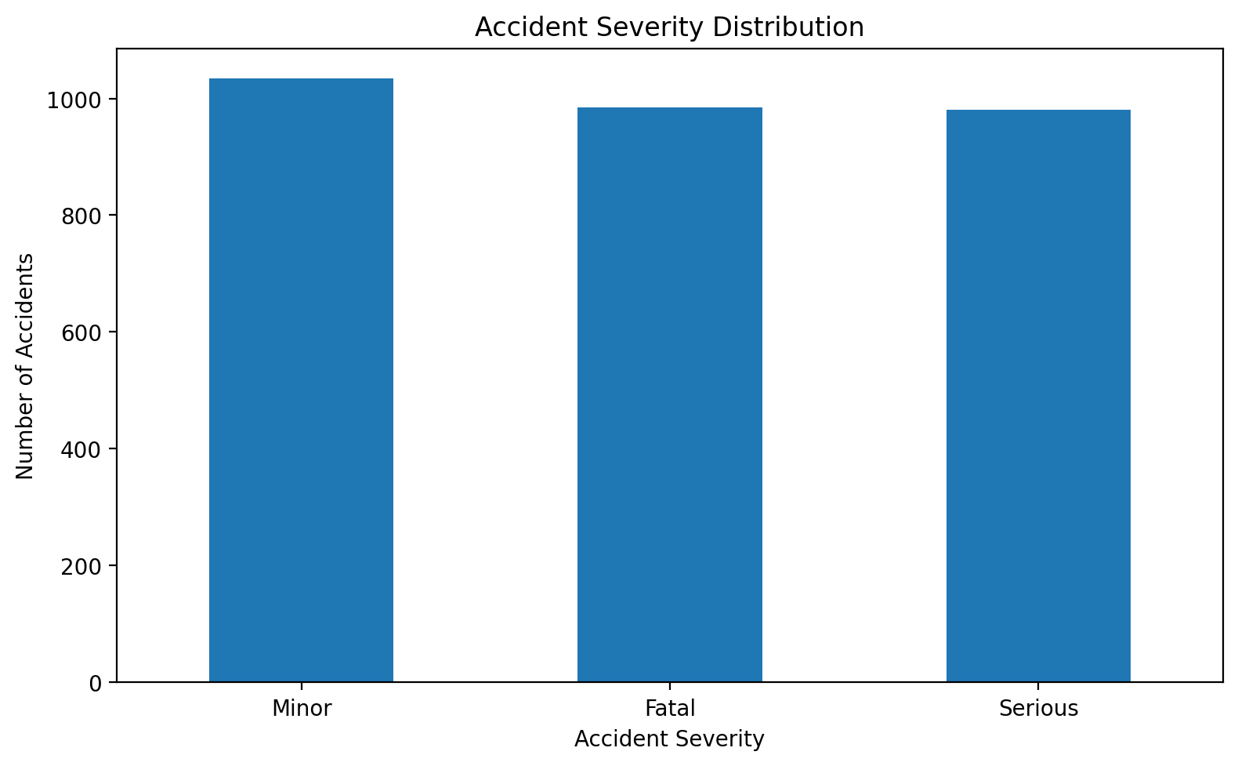
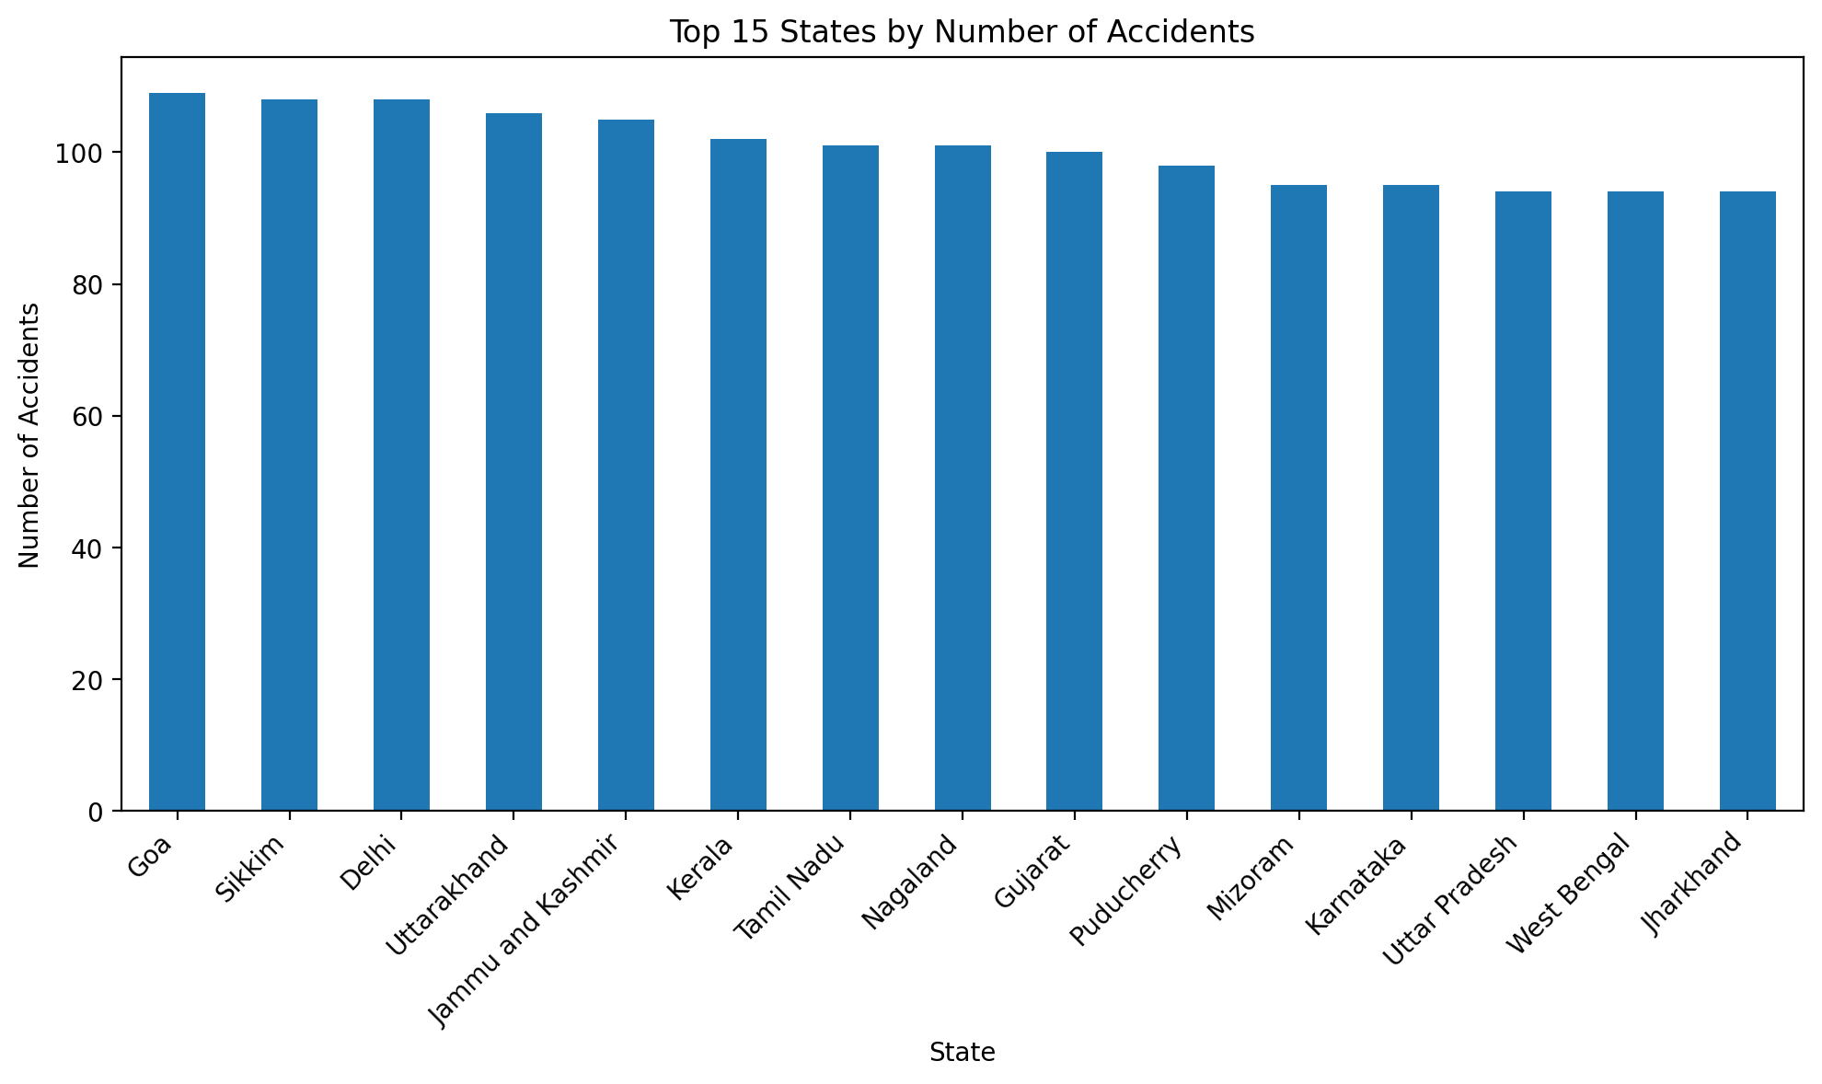
EXPLORATORY DATA ANALYSIS
EDA — Severity & Geographic Spread
Accident severity distribution
Top states by accident count
Severity classes are nearly balanced (Minor 1,034 · Fatal 985 · Serious 981), avoiding heavy class-imbalance bias. Goa, Sikkim, Delhi and Uttarakhand report the highest counts.
11

Slide 14
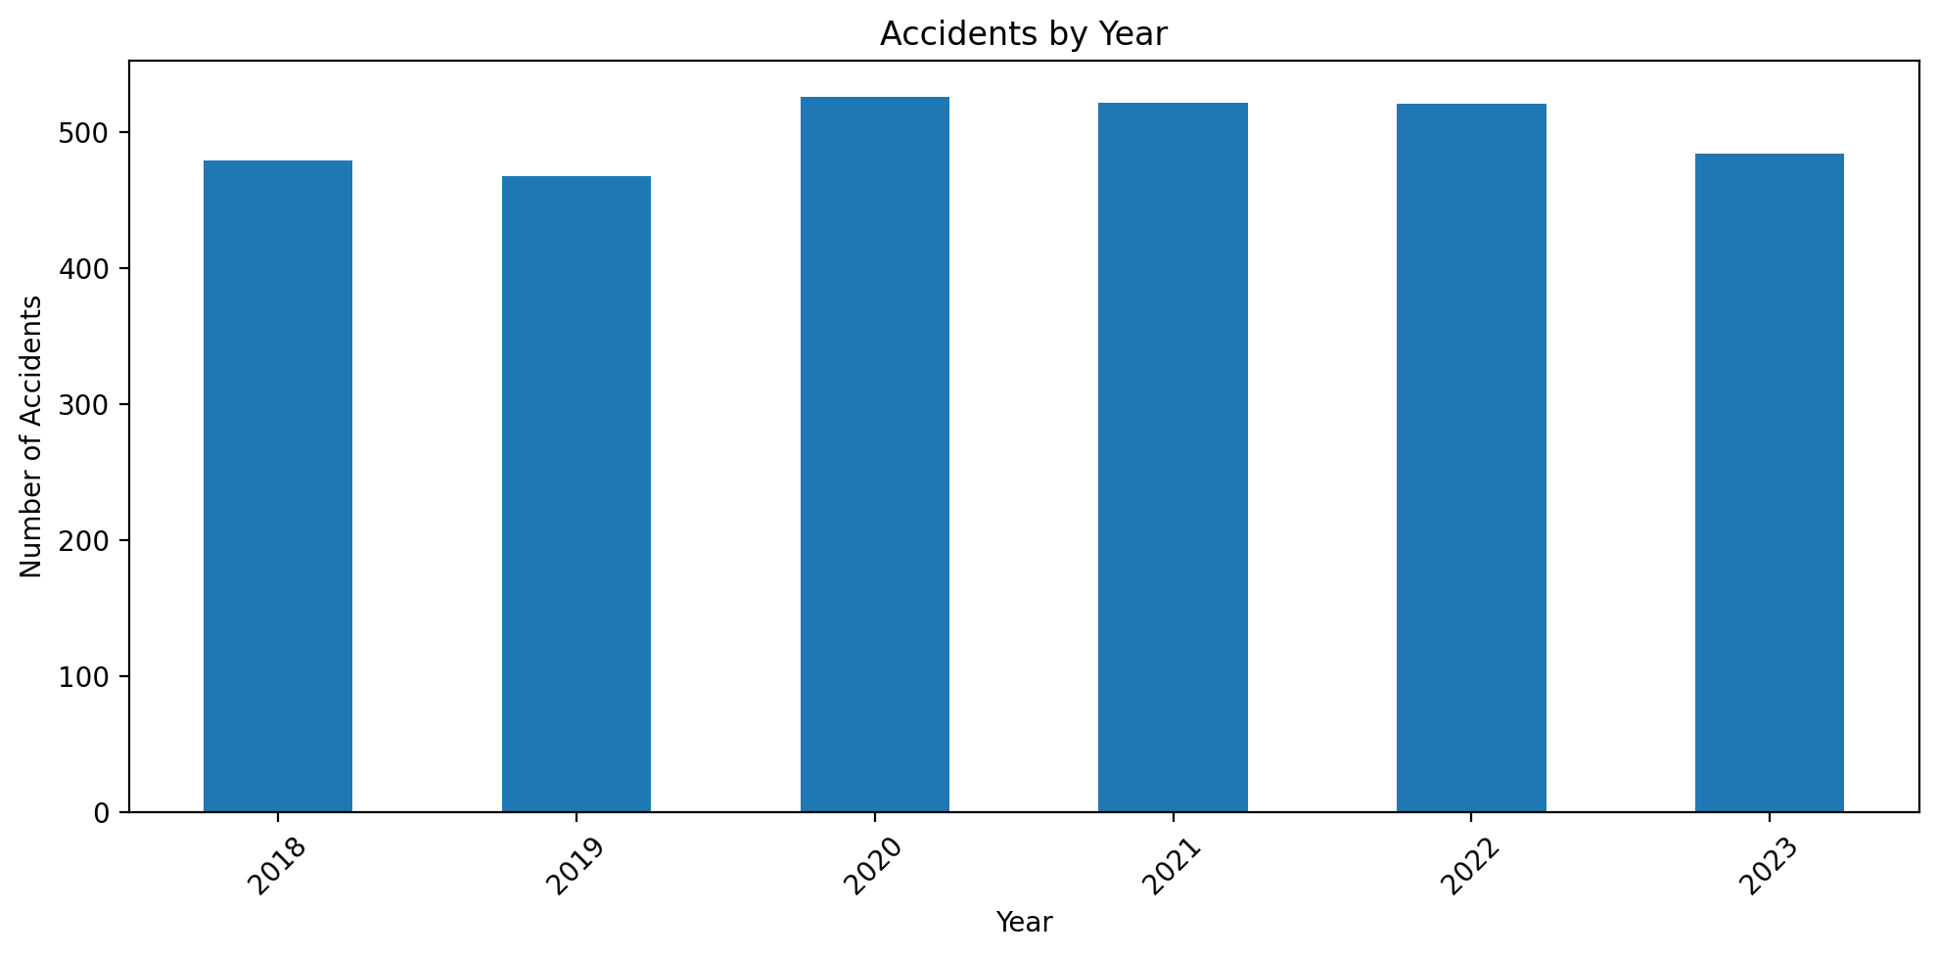
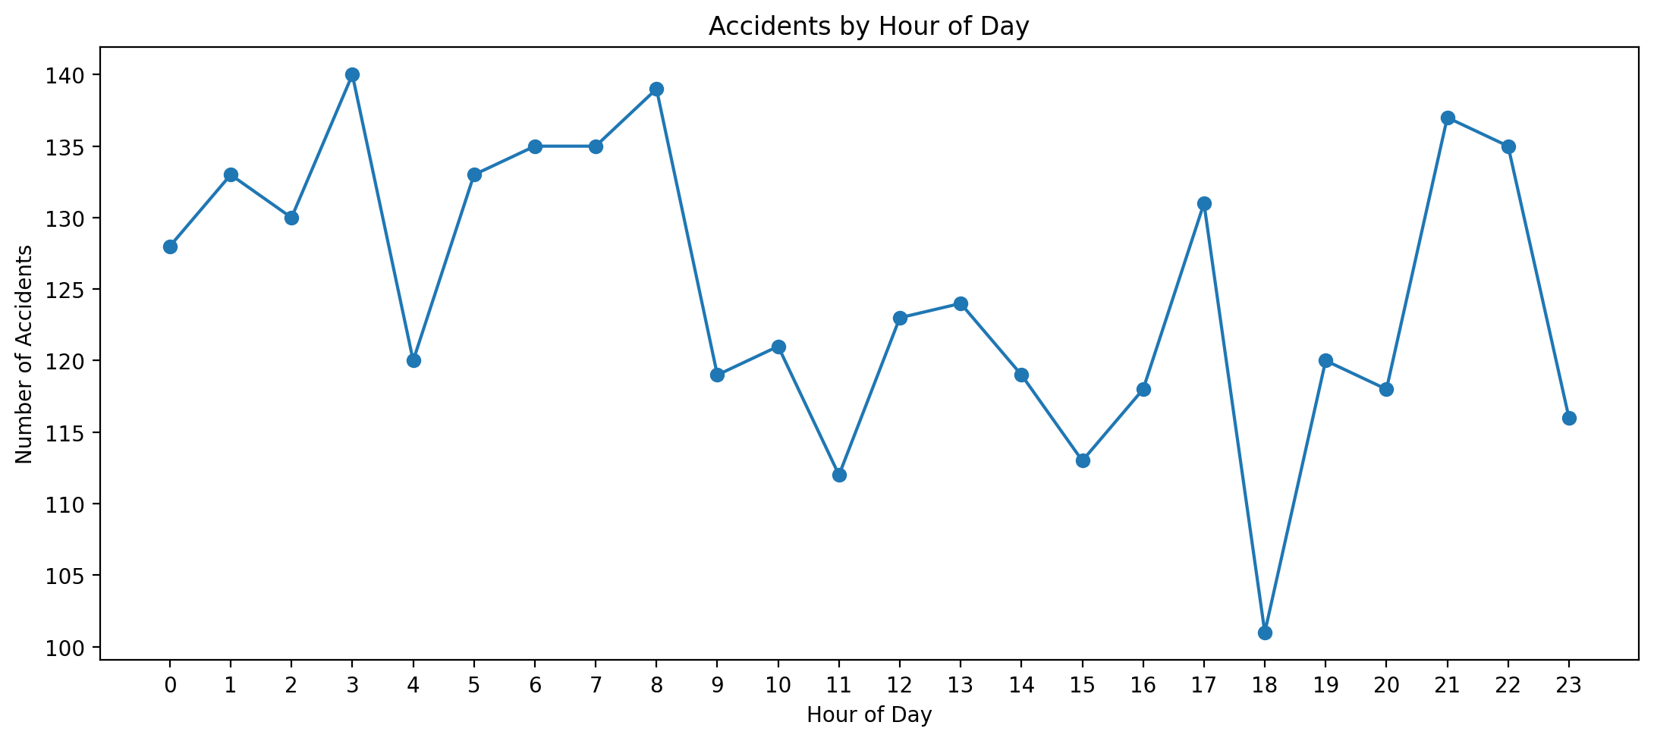
EXPLORATORY DATA ANALYSIS
EDA — Temporal Patterns
Accidents by year (2018–2023)
Accidents by hour of day
Accident counts stay broadly stable year over year (~470–525/year), with no single dominant hour — risk is spread across the day rather than concentrated in rush hour alone.
12

Slide 15
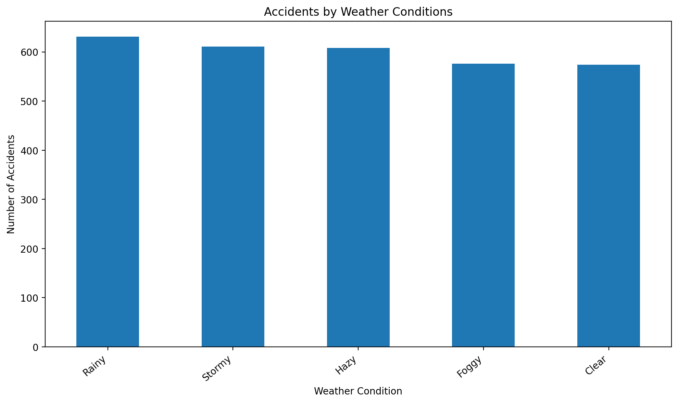
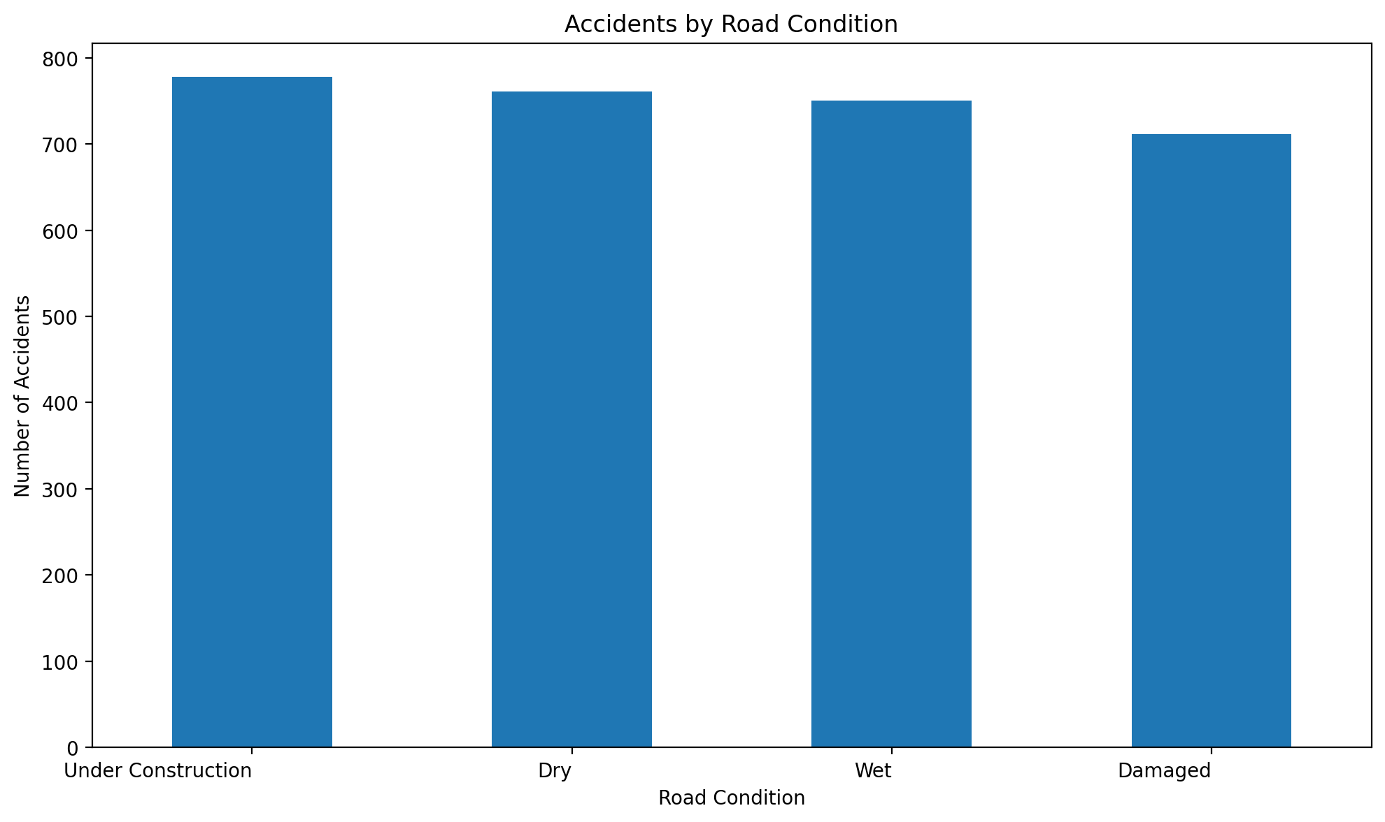
EXPLORATORY DATA ANALYSIS
EDA — Weather & Road Conditions
Weather conditions at accident time
Road condition at accident time
Rainy (631), Stormy (611) and Hazy (608) conditions account for the largest shares of recorded accidents — adverse weather is a recurring theme across the dataset.
13

Slide 16
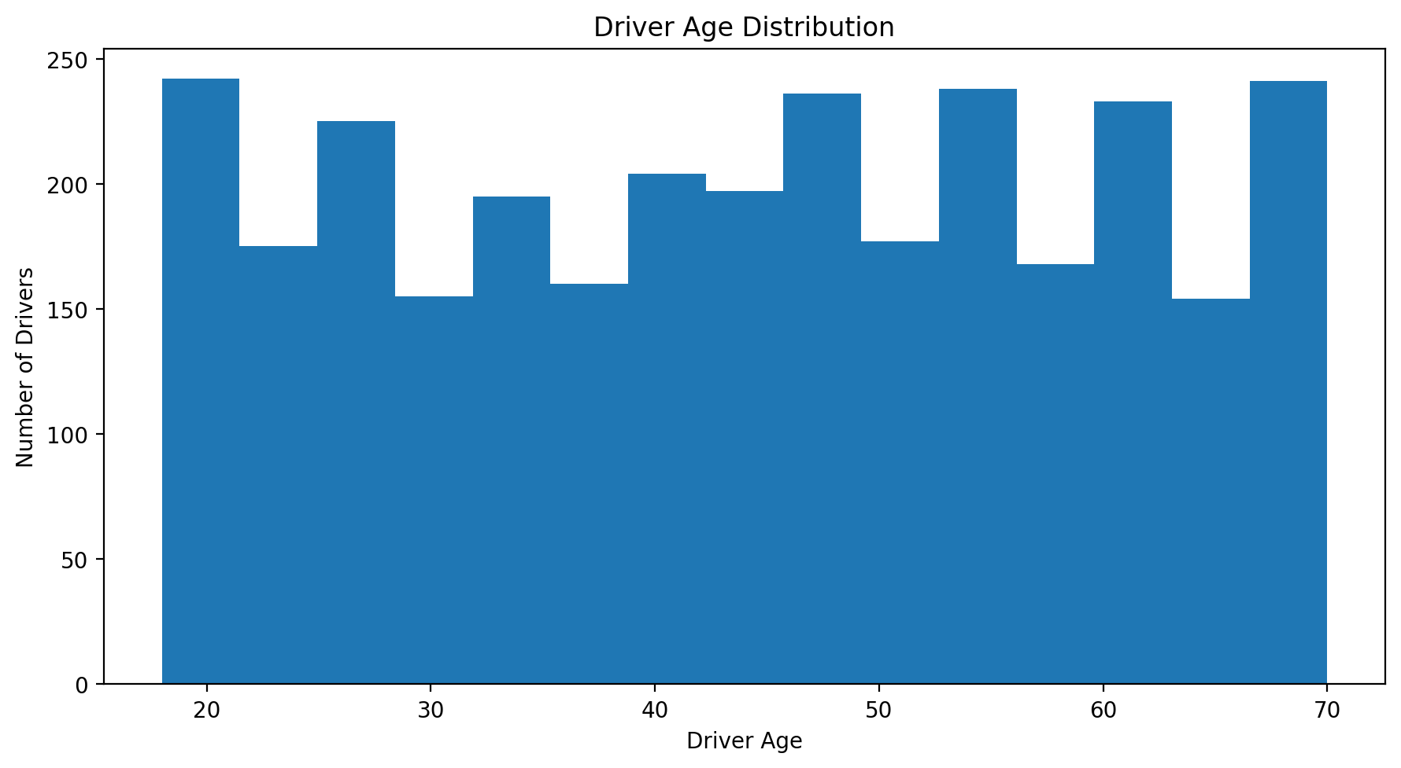
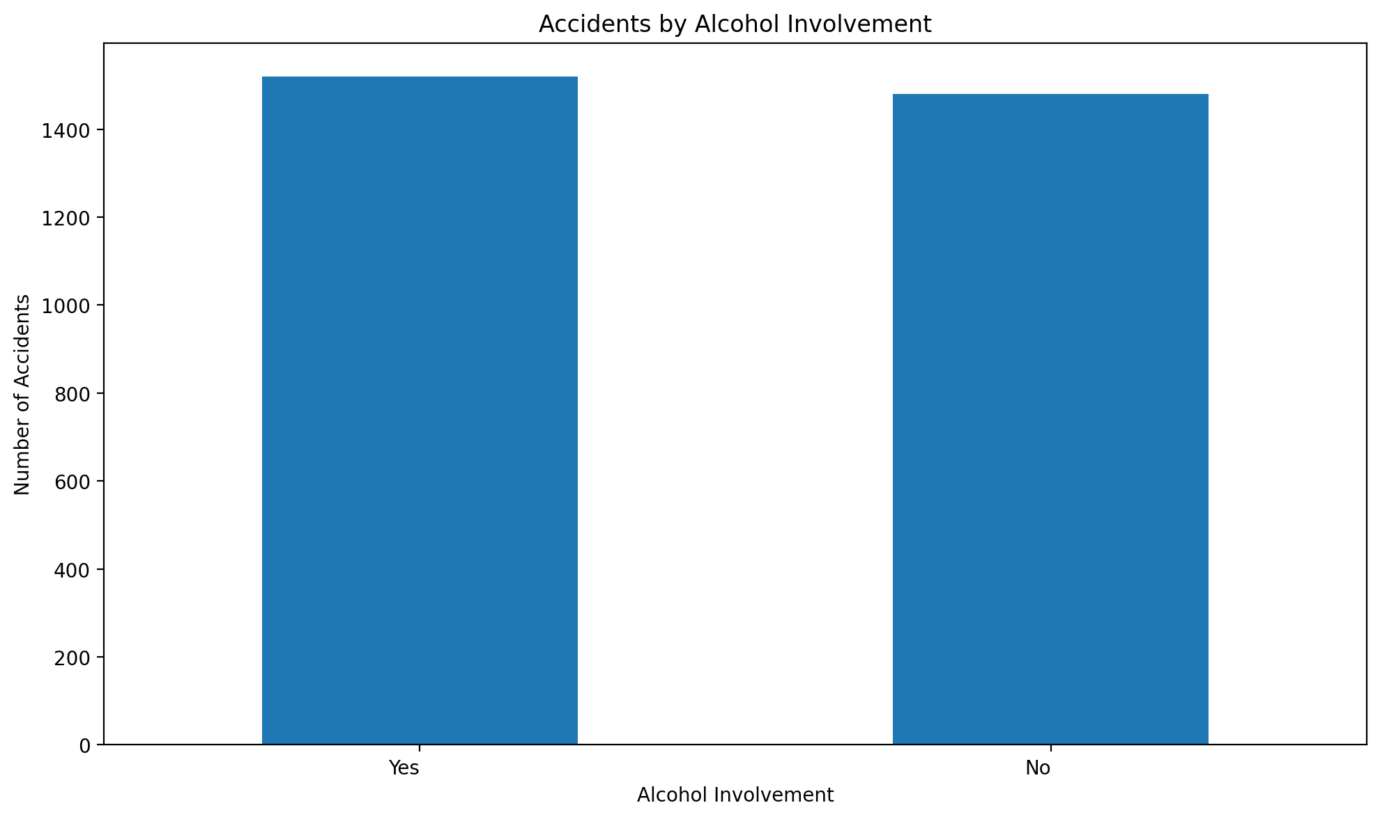
EXPLORATORY DATA ANALYSIS
EDA — Driver & Vehicle Factors
Driver age distribution
Alcohol involvement
Driver age spans the full working-age range with no single peak group. Alcohol was recorded as involved in 1,520 of 3,000 accidents (~51%) — a near-even split worth flagging for enforcement focus.
14

Slide 17
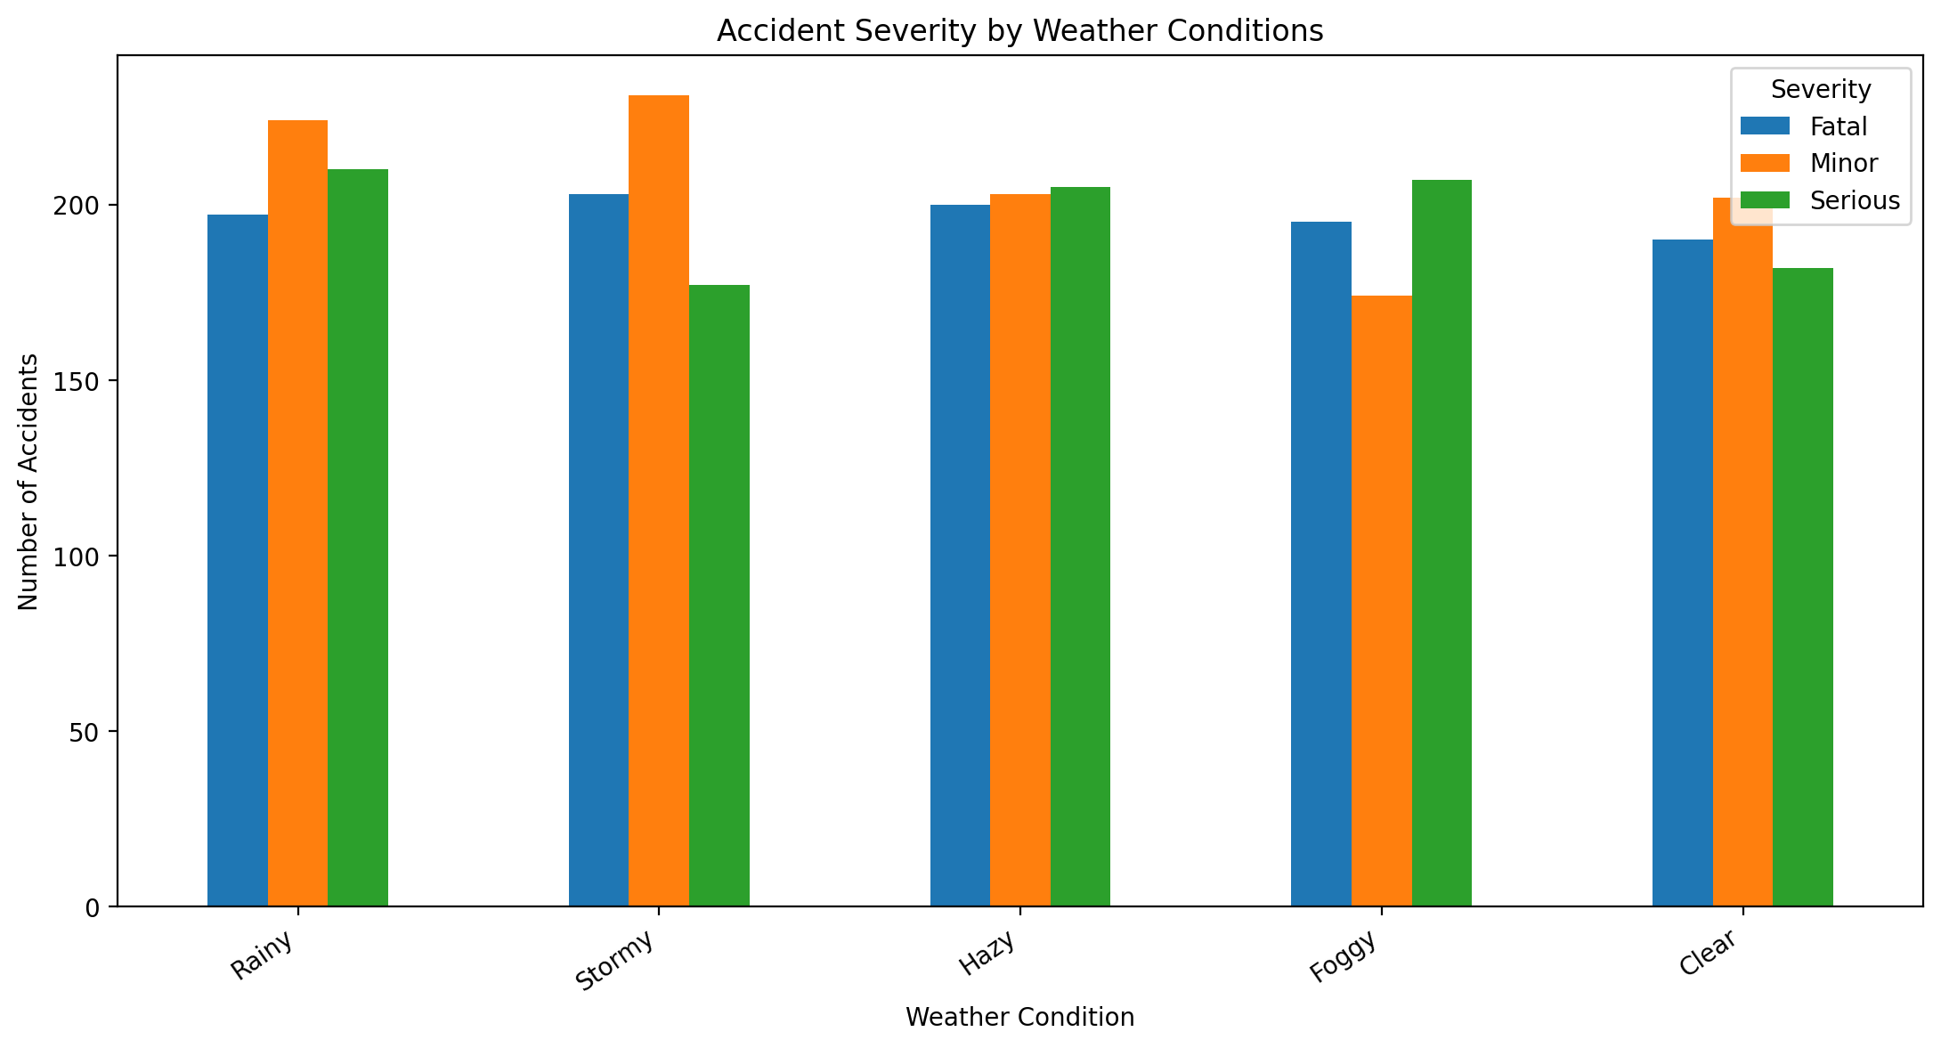
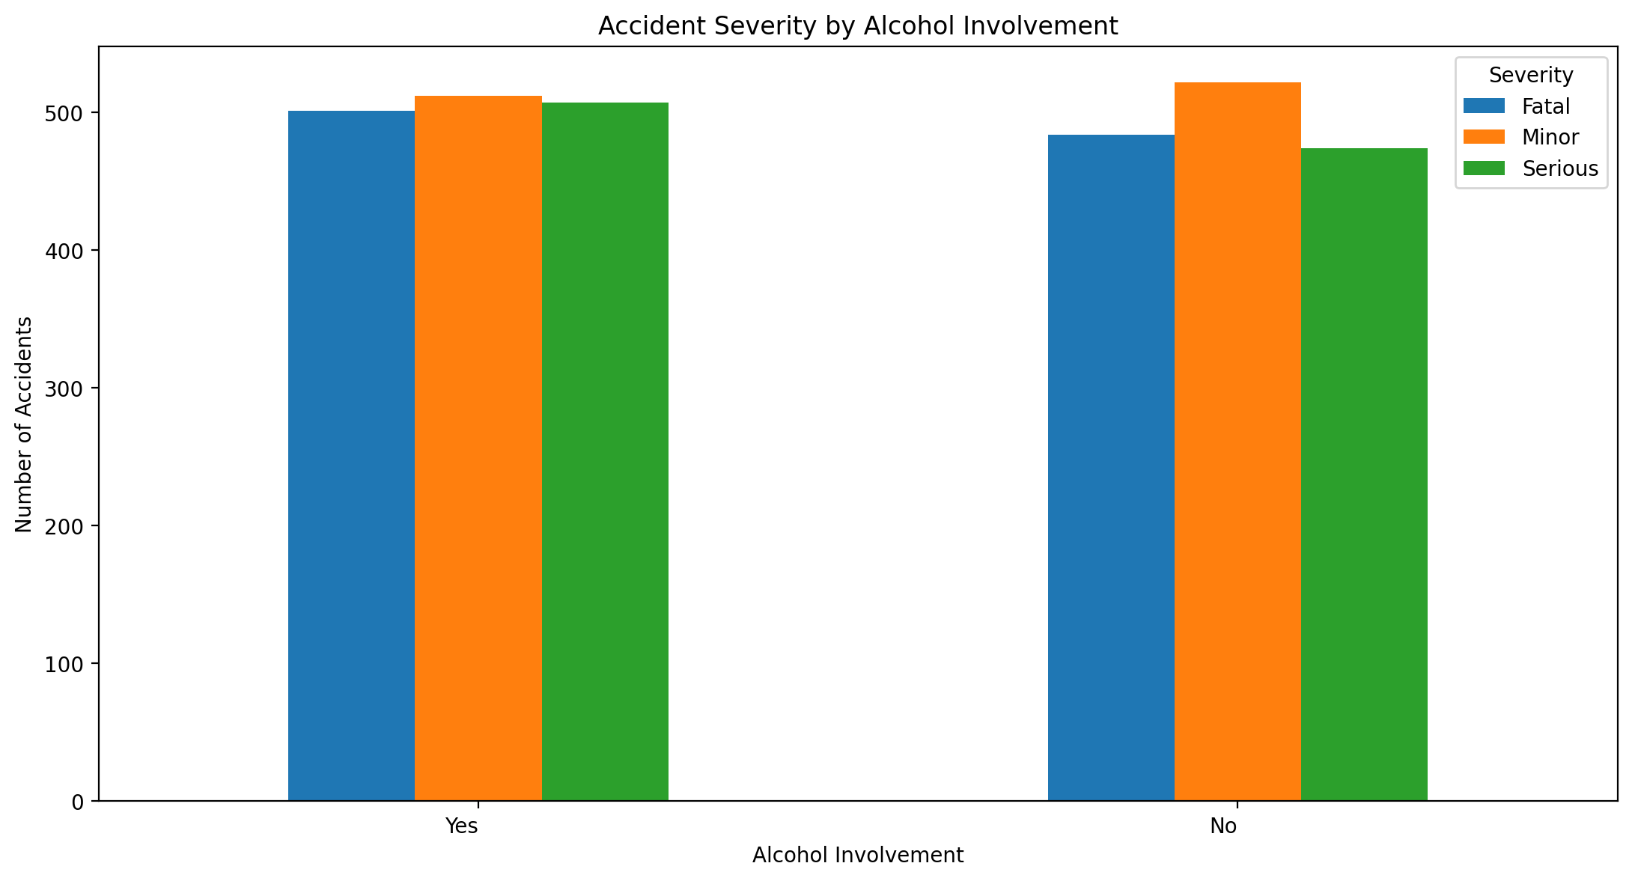
EXPLORATORY DATA ANALYSIS
EDA — What Relates to Severity
Severity by weather condition
Severity by alcohol involvement
Cross-tabulating severity against weather and alcohol involvement is the step that directly informs which features the models should weight most heavily.
15

Slide 18
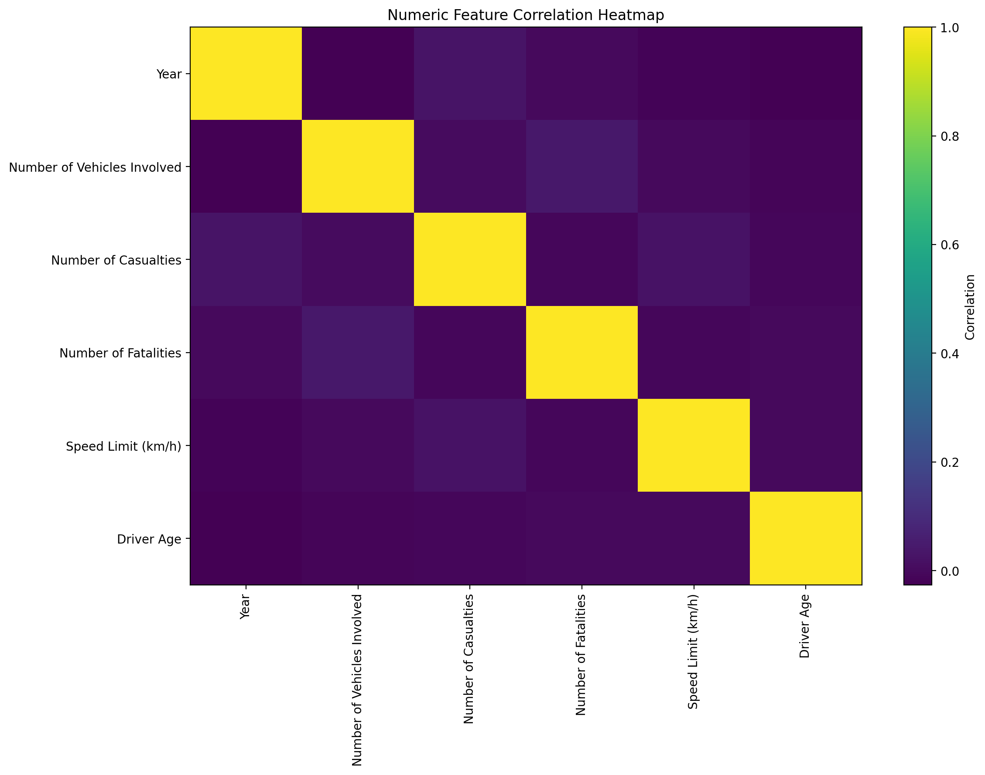
EXPLORATORY DATA ANALYSIS
EDA — Numeric Correlation Heatmap
Correlations among numeric fields (vehicles involved, casualties, fatalities, speed limit, driver age) are generally weak — confirming that severity depends more on categorical context (weather, road, alcohol) than on numeric values alone.
16

Slide 19
RESULTS
Model Evaluation Results
Reading the result
Random Forest edges out Logistic Regression (~35.7% vs ~35.3% accuracy), but both sit close to the 33% three-class baseline.
Takeaway: the recorded features carry only a weak signal for severity — the models agree more than they disagree, pointing to a data/feature-engineering limitation rather than an algorithm weakness.
17

Slide 20
RESULTS
Feature Importance — Random Forest
Top drivers of severity
Time of day and speed limit top the ranking — both are directly actionable for traffic enforcement and speed-zone policy.
Driver age and state follow closely, suggesting demographic and regional targeting could sharpen future models.
18

Slide 21
WRAP-UP
Key Findings & Conclusion
Severity classes are well-balanced (Minor / Fatal / Serious), so no resampling was required for this dataset.
Random Forest slightly outperformed Logistic Regression, confirming ensembles handle these mixed feature types marginally better.
Time of day, speed limit, driver age and state are the strongest predictors of accident severity.
Overall accuracy (~35%) shows the current feature set only weakly explains severity — a realistic, honestly-reported result.
Weather (rain, storms, haze) and alcohol involvement (~51% of cases) stand out as high-impact, policy-actionable factors.
The comparative workflow itself is reusable: it generalizes to other cities/states once richer location and behavioral data is added.
19

Slide 22
FUTURE SCOPE
Future Scope
Add real-time weather and traffic-density feeds for live risk scoring
Engineer richer spatial features (GPS coordinates, road-segment IDs) for true hotspot mapping
Test deep-learning approaches (CNN-LSTM) on a larger, multi-year dataset
Deploy as a Flask/Streamlit dashboard for traffic authorities
20

Slide 23
Thank You
Accident Hotspot Prediction Using Random Forest and Logistic Regression

